Slide 1
Microsoft Power BI

Slide 2
Introduction to App-Owns-Data Starter Kit
Ted Pattison
Principal Program Manager
Power BI Customer Advisory Team (PBICAT)

Slide 3
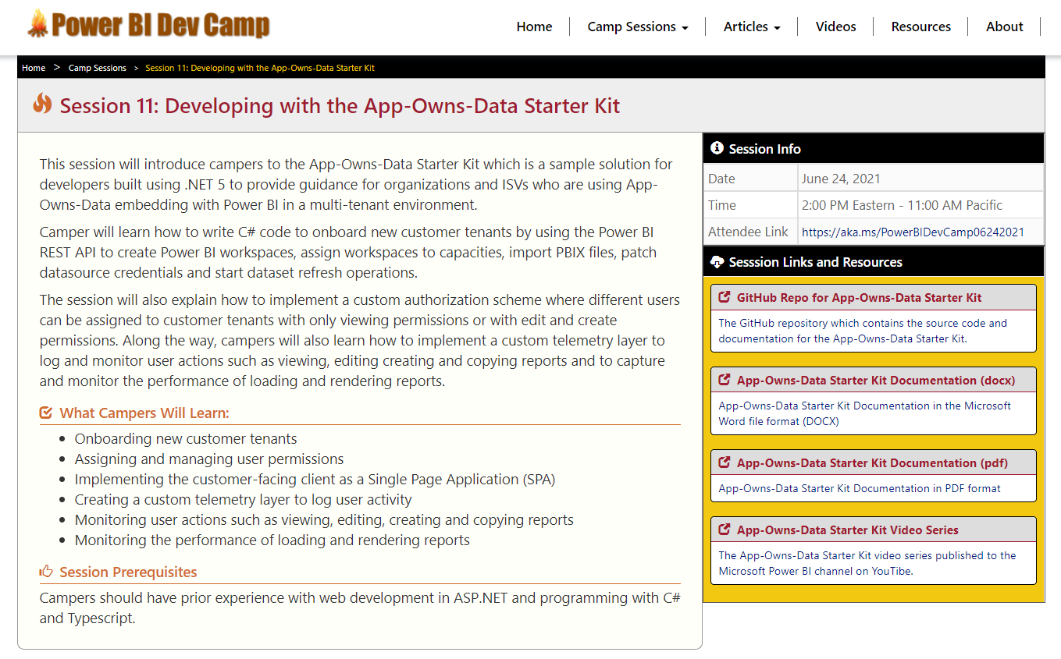
Welcome to Power BI Dev Camp
Power BI Dev Camp Portal - https://powerbidevcamp.net

Slide 4
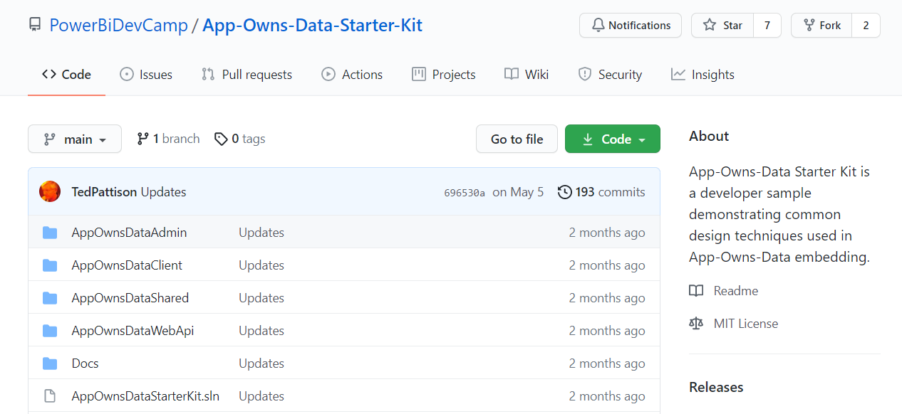
GitHub Repository with Developer Sample Code
All source code and documentation available through public GitHub repository
https://github.com/PowerBiDevCamp/App-Owns-Data-Starter-Kit

Slide 5
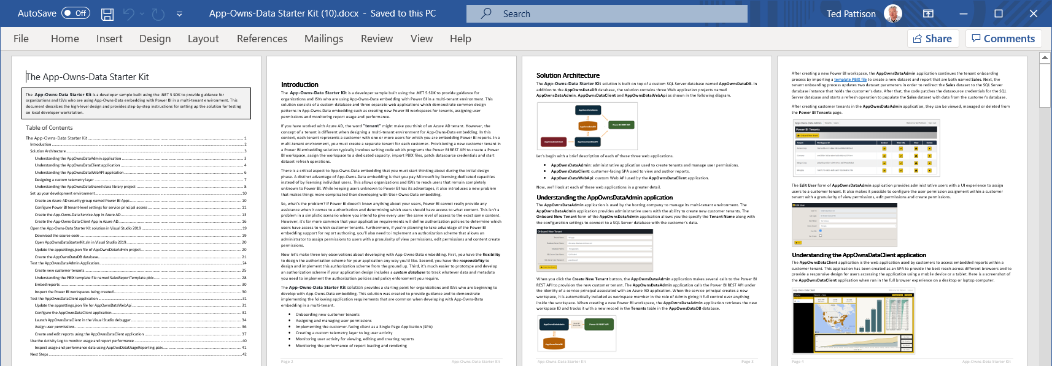
App-Owns-Data Starter Kit Documentation
Documentation available in several formats (~40 pages)
Online - https://github.com/PowerBiDevCamp/App-Owns-Data-Starter-Kit
DOCX – https://github.com/PowerBiDevCamp/App-Owns-Data-Starter-Kit/raw/main/Docs/App-Owns-Data%20Starter%20Kit.docx
PDF – https://github.com/PowerBiDevCamp/App-Owns-Data-Starter-Kit/raw/main/Docs/App-Owns-Data%20Starter%20Kit.pdf

Slide 6
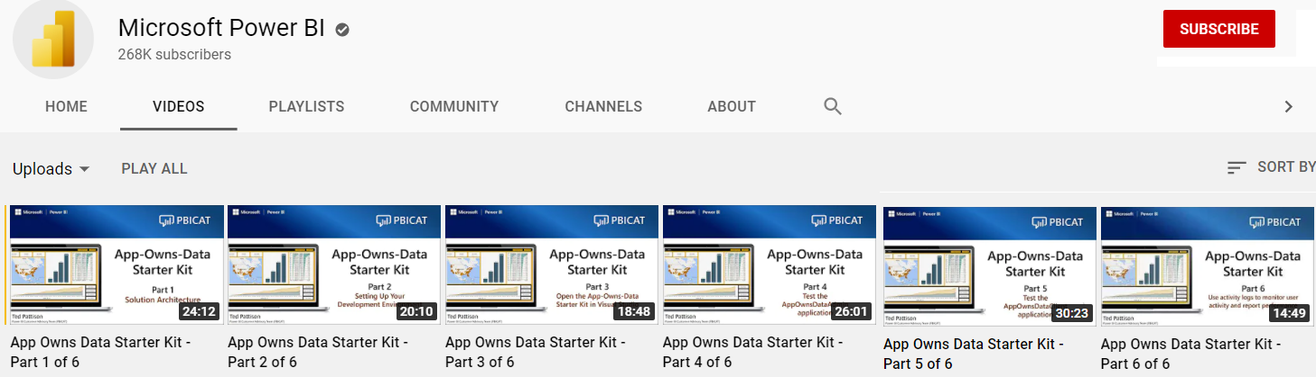
Video Series Published to Microsoft YouTube Channel
6 video series with detailed step-by-step walkthroughs
Available at https://www.youtube.com/c/MSPowerBI/videos
Thanks to Kelly Kaye and Daniel Zana for getting these published

Slide 7
Agenda
Solution Architecture
Test the AppOwnsDataAdmin application
Test the AppOwnsDataClient application
Monitor user activity and report performance

Slide 8

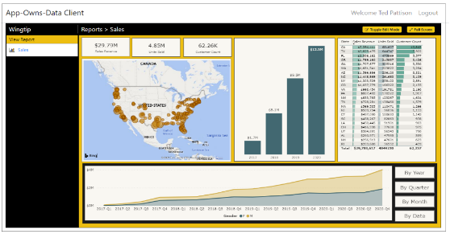
Customer Tenants in App-Owns-Data Embedding
Tenant represents a customer with one or more users
You must create a separate tenant footprint in Power BI for each customer
Power BI environment
Customer 01
17 users
Customer 01 Tenant
Sales
Power BI Workspace
Power BI Dataset
Datasource credentials
Power BI Report

Slide 9
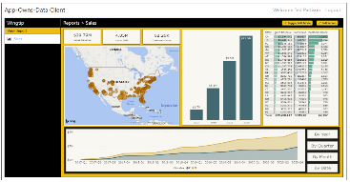
Designing a Multi-tenant Environment
Power BI Multi-tenant Environment
Customer 01
17 users
Customer 01 Tenant
Sales
Power BI Workspace
Power BI Dataset
Datasource credentials
Power BI Report
Customer 02
243 users
Customer 02 Tenant
Sales
Power BI Workspace
Power BI Dataset
Datasource credentials
Power BI Report
Customer N
74 users
Customer N Tenant
Sales
Power BI Workspace
Power BI Dataset
Datasource credentials
Power BI Report

Slide 10
App-Owns-Data Embedding & Authorization
Power BI doesn’t know anything about your users
Power BI cannot provide assistance when it comes to authorization
Not an issue in scenario where all users see all content with the same access
Your application must add explicit support for any authorization scheme
Key observations about App-Owns-Data embedding
you have flexibility to design the authorization scheme any way you'd like
you have responsibility to build authorization scheme from the ground up
you should use custom database to track the authorization data you need

Slide 11
App-Owns-Data Starter Kit - Value Proposition
Provides guidance for the following tasks and procedures
Onboarding new customer tenants
Managing user permissions
Implementing customer-facing client as Single Page Application (SPA)
Creating custom telemetry layer to log user activity
Monitoring user actions such as viewing, editing, and creating reports
Monitoring report performance across all customer tenants

Slide 12
Solution Architecture
AppOwnsDataDB: custom database to track tenants, user permissions and user activity
AppOwnsDataAdmin: administrative app to create tenants and manage user permissions
AppOwnsDataClient: customer-facing SPA used to view and author reports
AppOwnsDataWebApi: custom Web API used by the AppOwnsDataClient application
AppOwnsDataAdmin
AppOwnsDataDB
Power BI REST API
AppOwnsDataClient
AppOwnsDataWebApi

Slide 13
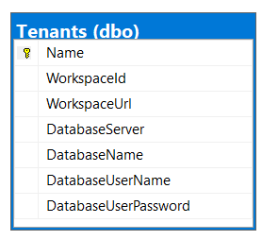
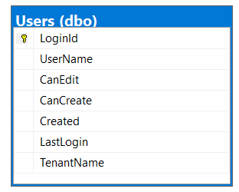
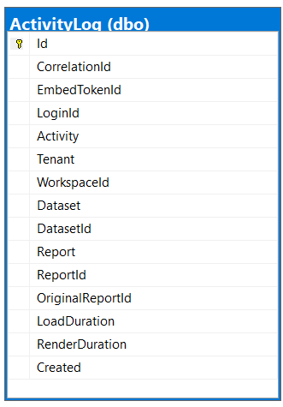
Database Schema for AppOwnsDataDB
Tenants table tracks Power BI workspace Id and customer database connection info
Users table tracks user profile with tenant assignment and permissions within tenant
ActivityLog table tracks telemetry data about user activity and report performance

Slide 14
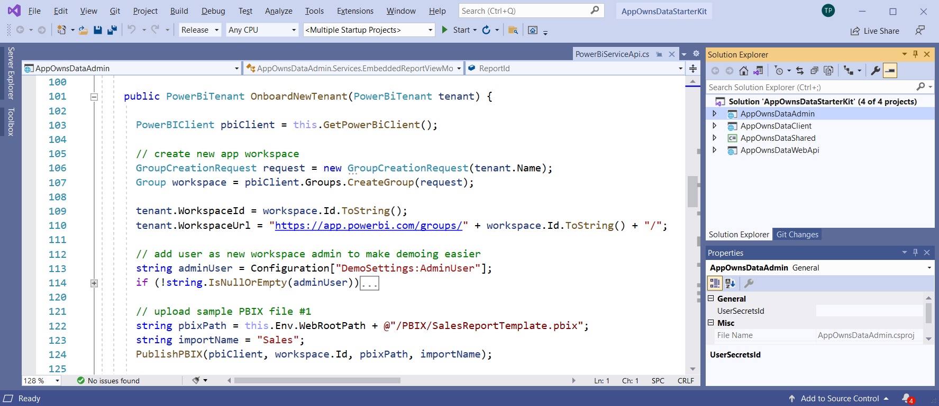
The App-Owns-Data Starter Kit Solution
Created as POC to provide starting point for ISVs and large organizations
Built using .NET 5 and ASP.NET CORE
Uses Entity Framework Core to design and generate AppOwnsDataDB
Can be opened and tested with Visual Studio 2019 or Visual Studio Code
Designed for simple App-Owns-Data scenario – extend it to meet your requirements

Slide 15
Agenda
Solution Architecture
Test the AppOwnsDataAdmin application
Test the AppOwnsDataClient application
Monitor user activity and report performance

Slide 16
AppOwnsDataAdmin
Uses Power BI REST API to provision workspaces for customer tenants
Calls to Power BI REST API as a service principal – not as a user
Adds a record to AppOwnsDataDB for each customer tenant
AppOwnsDataAdmin
Power BI REST API
Azure AD Service App
AppOwnsDataDB

Slide 17
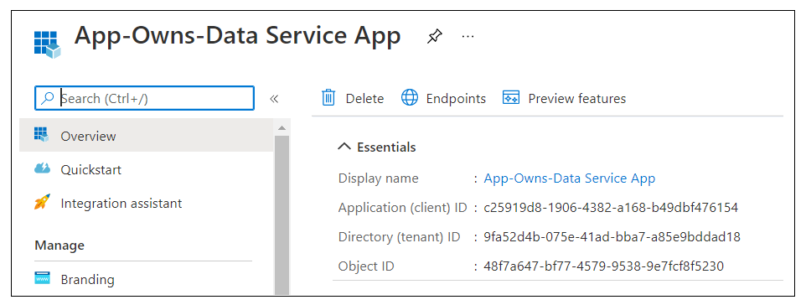
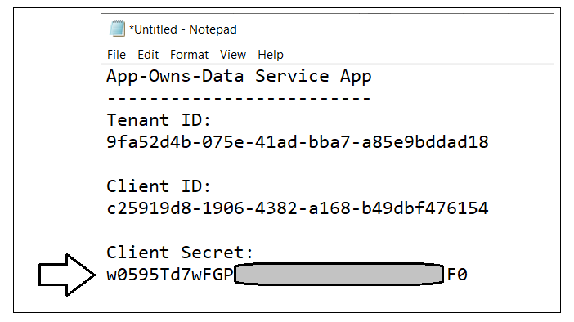
Create the App-Owns-Data Service App
Understanding the App-Owns-Data Service App
Azure AD application used to authenticate as service principal
Used by both AppOwnsDataAdmin and AppOwnsDataWebApi
You need to record Tenant ID, Client ID and Client Secret when creating application
Tenant ID, Client ID and Client Secret used to implement client credentials flow

Slide 18
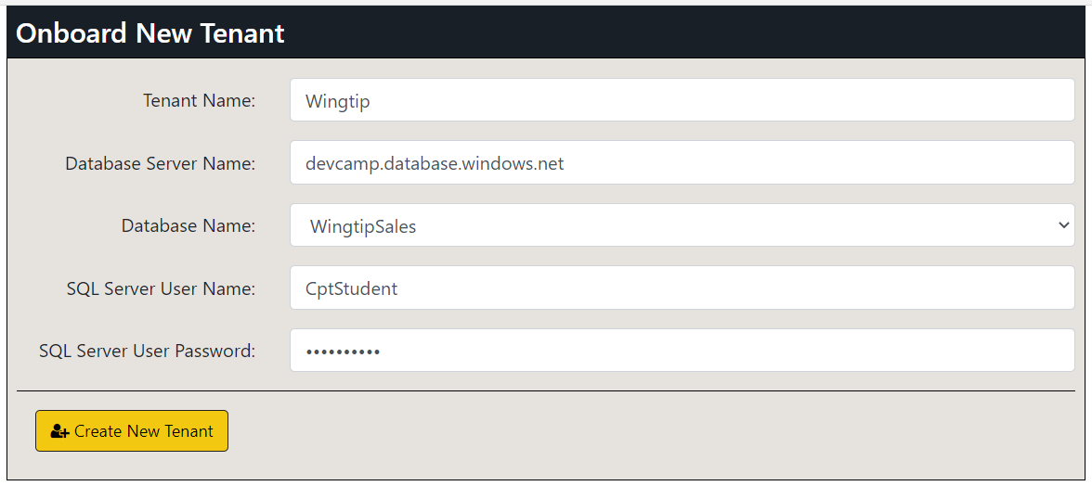
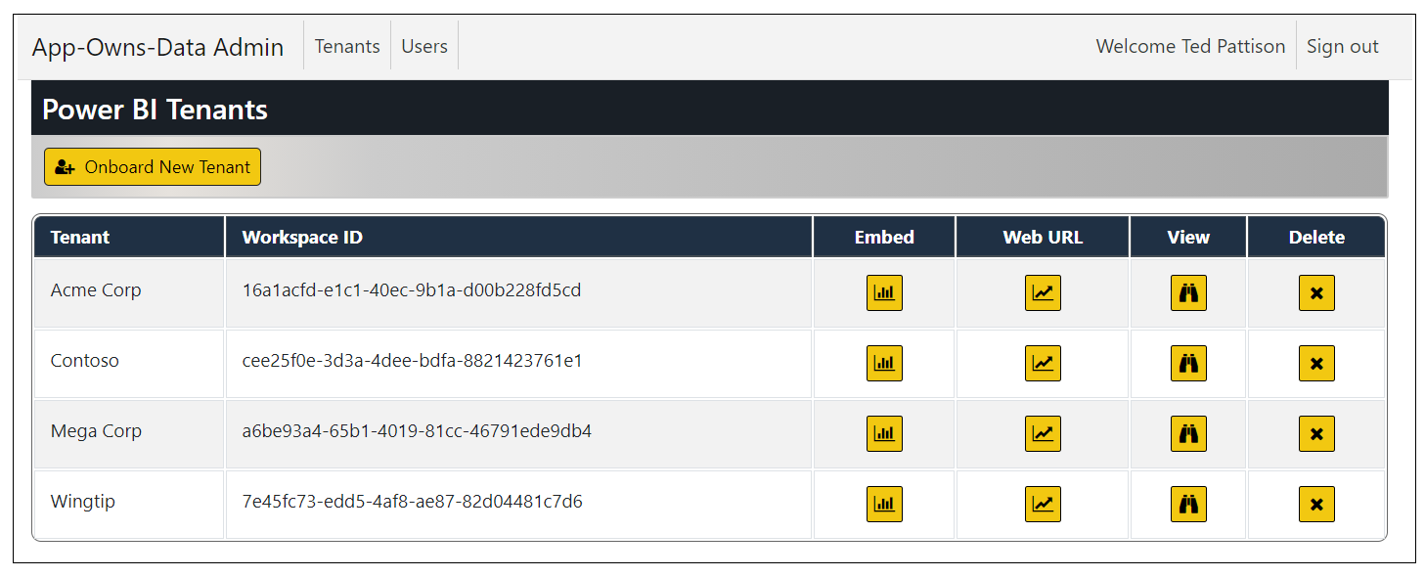
Creating Customer Tenants
AppOwnsDataAdmin provides Onboard New Tenant page
Behind the scenes, AppOwnsDataAdmin creates and configures Power BI workspace
Makes is possible to configure details for connection to customer database
Tenants can be viewed or deleted

Slide 19
Sequence of Tenant Provisioning Operations
Create a new Power BI workspace
Assign workspace to a dedicated capacity
Import template PBIX files to create datasets and reports
Update dataset parameters to redirect datasource to customer’s database
Patch datasource credentials
Start dataset refresh operations

Slide 20
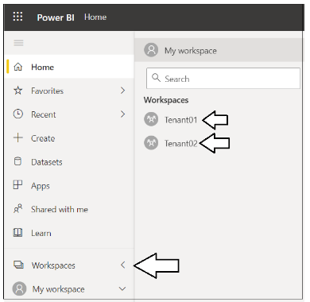
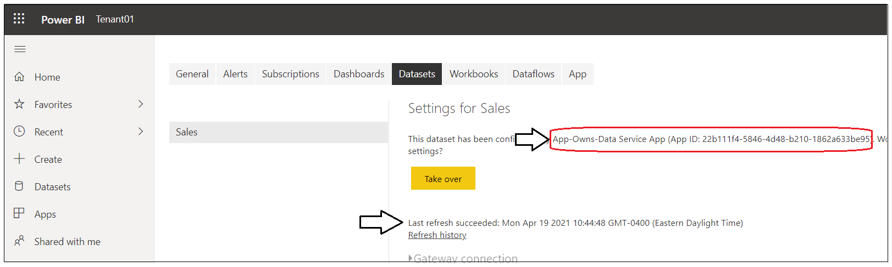
What’s been created in Power BI?
You can see the workspaces created in Power BI
There should be a Power BI workspace for each tenant that’s been created
ConfiguredBy property of Sales dataset should be set to App-Owns-Data Service App
Last refresh time should reflect refresh operation at end of onboarding process

Slide 21
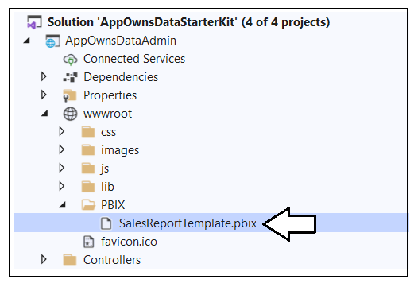
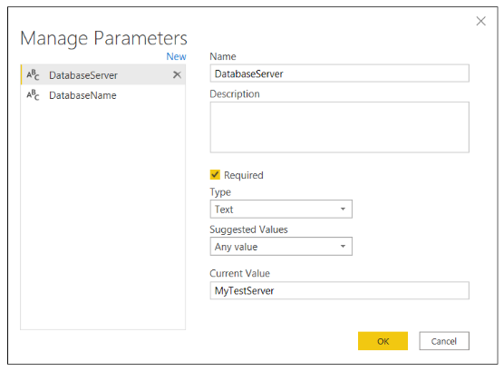
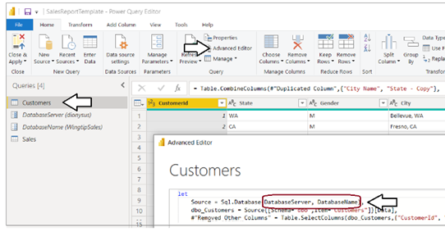
Understanding SalesReportTemplate.pbix
AppOwnsDataAdmin uses SalesReportTemplate.pbix as PBIX template file
PBIX import process creates Sales dataset and Sales report
Sales dataset parameterized with DatabaseServer and DatabaseName
Dataset parameters updated after import to redirect Sales dataset to customer database

Slide 22
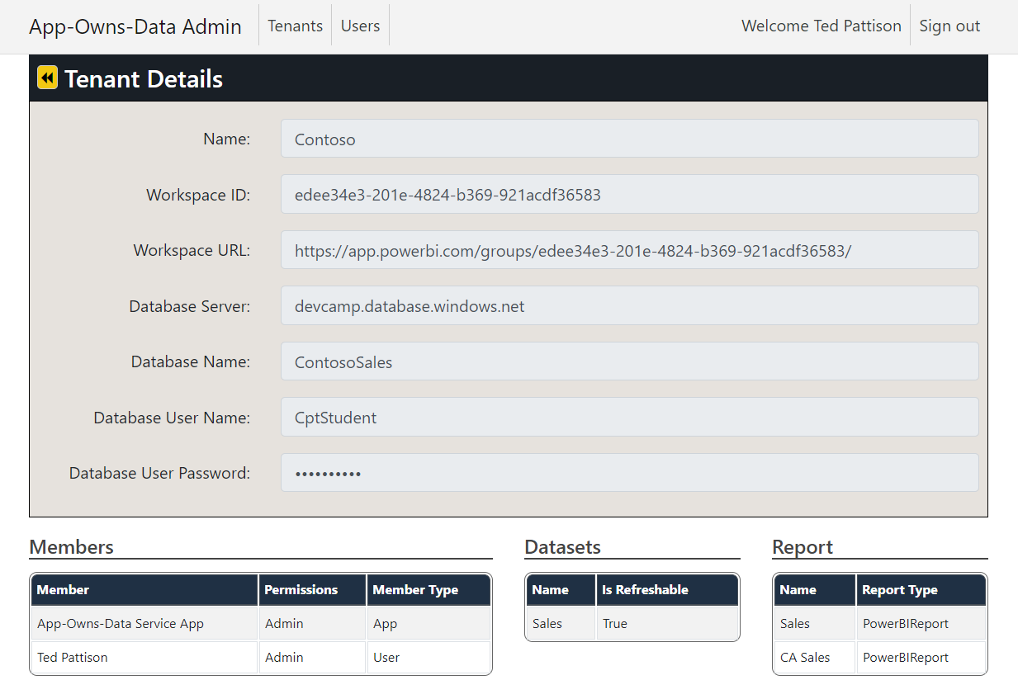
Tenant Details
Tenant Details page lists members, datasets and reports
AppOwnsDataAdmin calls Power BI REST API to discover workspace artifacts

Slide 23
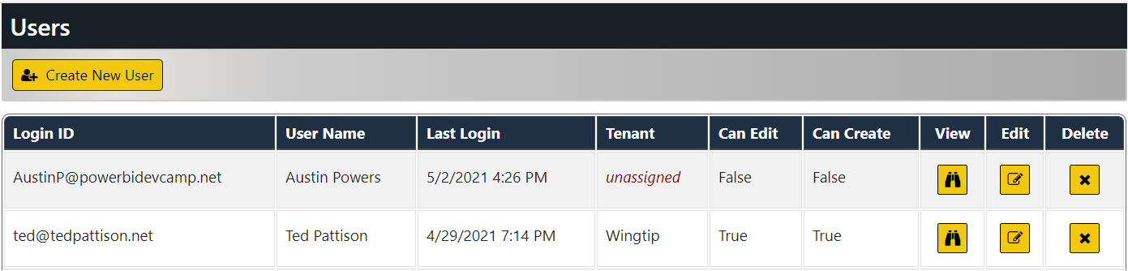
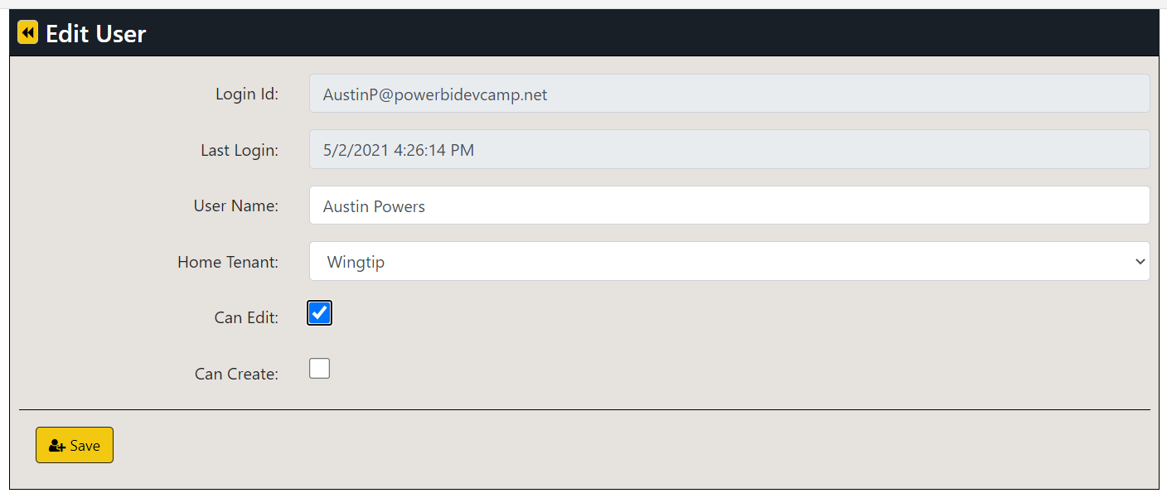
Managing User Permissions
Edit User page make it possible to assign user to a customer tenant
Users can optionally be assigned edit permissions and create permissions

Slide 24
Demo Time Running the AppOwnsDataAdmin Application

Slide 25
Agenda
Solution Architecture
Test the AppOwnsDataAdmin application
Test the AppOwnsDataClient application
Monitor user activity and report performance

Slide 26
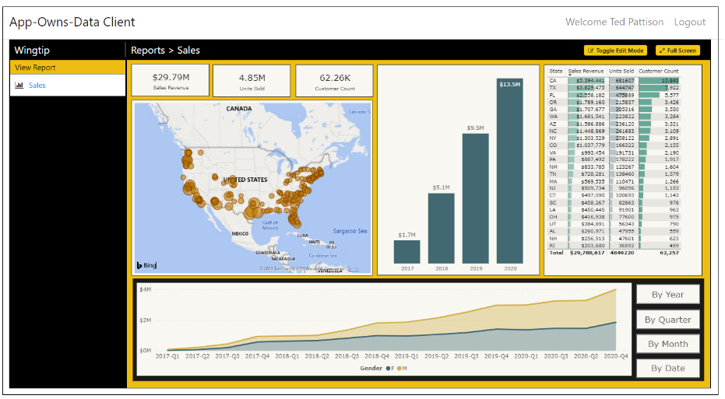
AppOwnsDataClient
Built as simple Single Page Application (SPA)
Client authenticates user and acquires access tokens to call AppOwnsDataWebApi
Project configured with node.js and webpack to support Typescript compilation
Project includes node.js packages for jQuery and Power BI JavaScript API
Project easily extended to support development with React or Angular
AppOwnsDataClient
Azure AD
Client App
AppOwnsDataWebApi

Slide 27
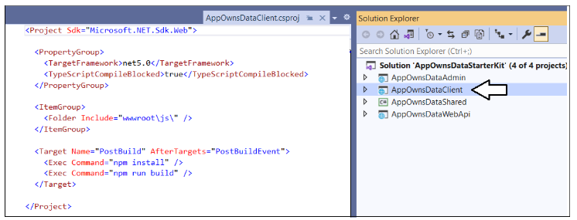
Node.js integration
AppOwnsDataClient project built as a Node.js project
You must install Node.js in order to build the project
npm install command used to restore Node.js packages
npm run build command triggers webpack to compile Typescript into JavaScript

Slide 28
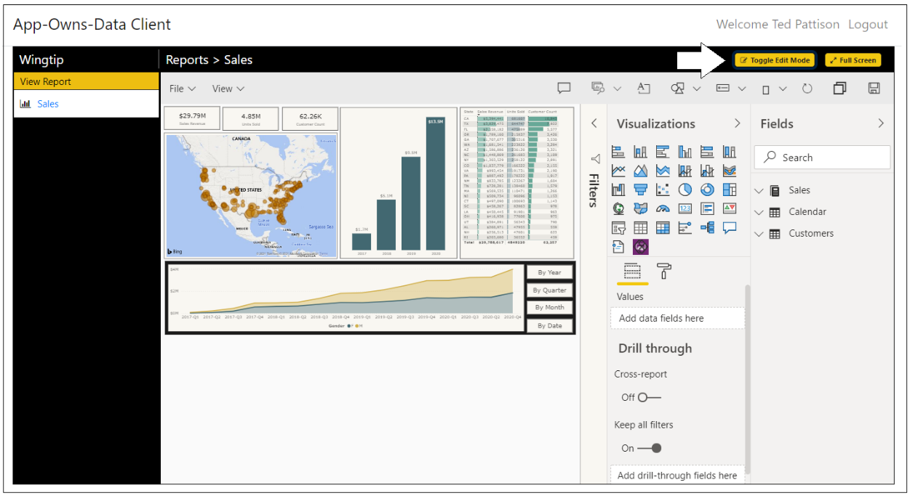
Report Authoring
AppOwnsDataClient demonstrates report authoring features
Users with edit permissions can move report into edit view and customize layout
Users with create permissions can copy existing reports and create new reports

Slide 29
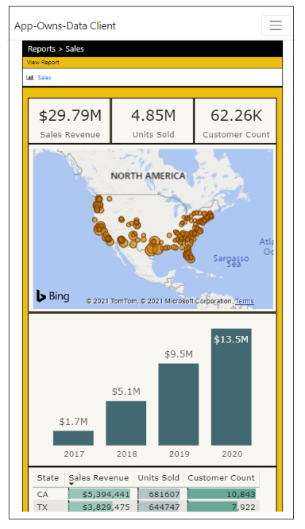
Responsive Design
Supporting mobile devices is a common application requirement
AppOwnsDataClient demonstrates responsive design strategy
Power BI report template designed with master view and mobile view
Client app has logic to switch between master view and mobile view

Slide 30
Identity Providers and App-Owns-Data Development
App-Owns-Data development allows you to pick any identity provider
Identity provider responsible for authenticating user and validating LoginId
App-Owns-Data Starter Kit uses Azure AD as client app identity provider
Solution architecture designed to facilitate switching out the identity provider
AppOwnsDataClient
Azure AD
AppOwnsDataWebApi
AppOwnsDataClient
OneLogin
AppOwnsDataWebApi
AppOwnsDataClient
PING
AppOwnsDataWebApi
AppOwnsDataClient
AppOwnsDataWebApi
AppOwnsDataClient
Auth0
AppOwnsDataWebApi
Okta

Slide 31
AppOwnsDataWebApi
Provides service-oriented architecture endpoints for AppOwnsDataClient
Provides endpoint to process user login
Provides endpoint to retrieve embedding data and embed tokens
Provides endpoint to log activity events to be recorded in AppOwnsDataDB
AppOwnsDataClient
AppOwnsDataWebApi
Power BI REST API
Azure AD Client App
Azure AD Service App
AppOwnsDataDB

Slide 32
Using a single service principal
AppOwnsDataAdmin calls Power BI REST API to create and configure workspaces
AppOwnsDataWebApi calls Power BI REST API to generate embed data & embed tokens
Both applications run under identity of single service principal
Service principal has admin permissions on any workspaces that it creates
AppOwnsDataAdmin
App-Owns-Data Service App
Power BI REST API
AppOwnsDataWebApi
App-Owns-Data Service App

Slide 33
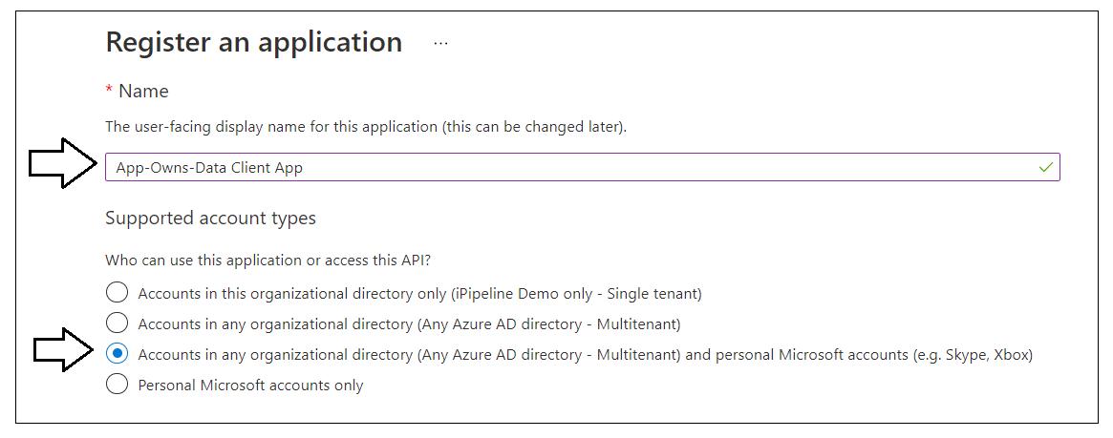
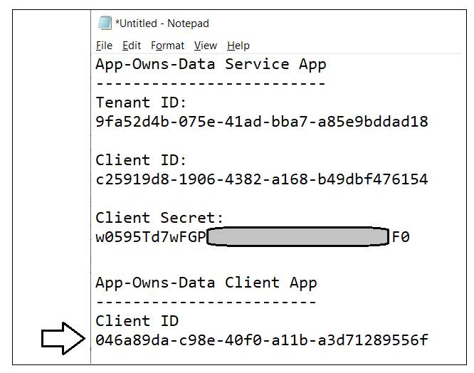
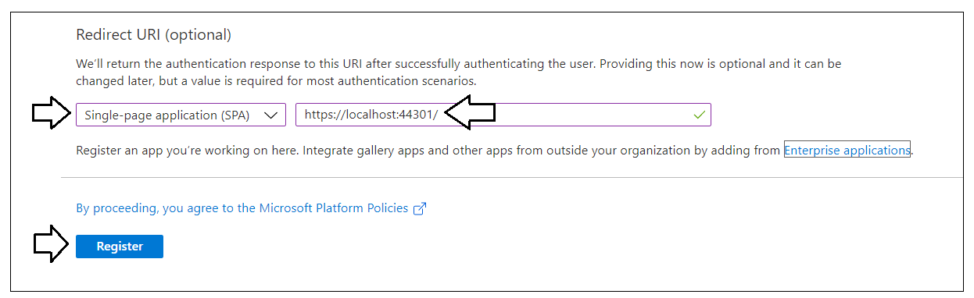
Create the App-Owns-Data Client App
Azure AD application used to authenticate user of AppOwnsDataClient
Users can authenticate using any Microsoft organizational or personal account
Authentication allows AppOwnsDataWebApi to validate LoginId of current user
AppOwnsDataWebApi and AppOwnsDataClient both configured with this Client ID
Remember – you don’t have to use Azure AD as the identity provider

Slide 34
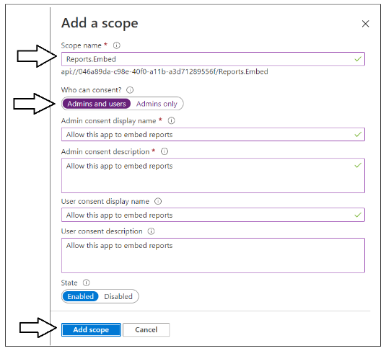
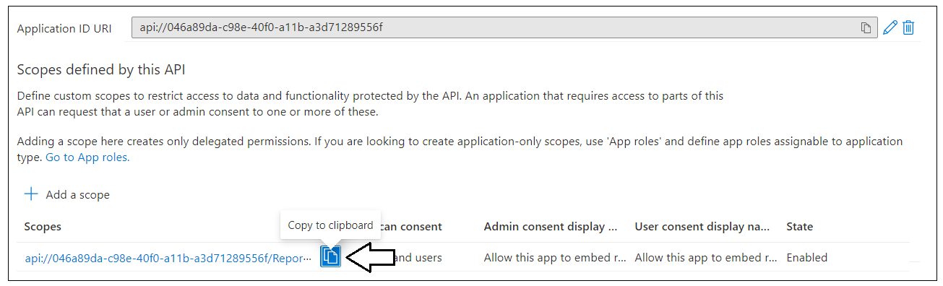
Creating a Custom Scope for AppOwnsDataWebApi
App-Owns-Data Client App used to secure a custom Web API
Securing Web API with Azure AD application requires creating custom scope
Set up requires creating custom scope in App-Owns-Data Client App named Reports.Embed
Scope identifier created in the format of api://[CLIENT_ID]/Reports.Embed

Slide 35
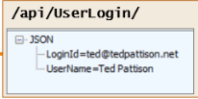
User Login
AppOwnsDataClient calls UserLogin endpoint after authenticating user
AppOwnsDataWebApi updates last login time for existing users
AppOwnsDataWebApi creates new record for first-time users
New users have no access to content until they are assigned to a customer tenant
AppOwnsDataClient
AppOwnsDataWebApi

Slide 36
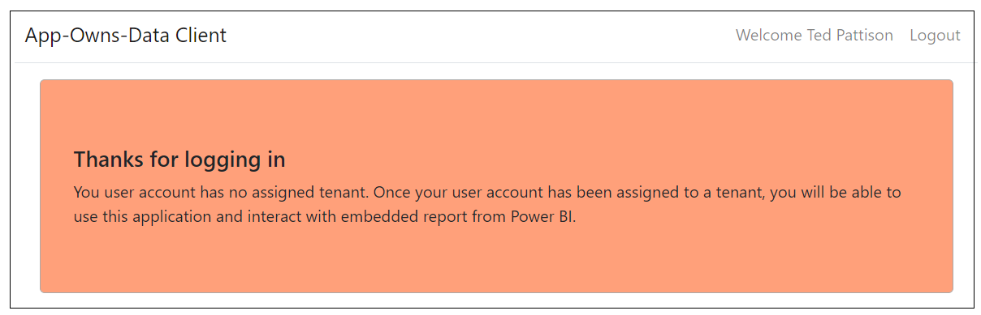
Unassigned users have no access to content
New users created without being assigned to tenant
Users see message shown below until they are assigned to tenant

Slide 37
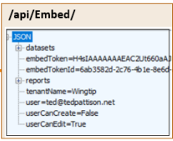
Embedding Data View Model
AppOwnsDataWebApi returns view model to AppOwnsDataClient
View model contains embedding data for reports and datasets
View model contains embed token used to embed reports
Embed tokens contains set of permissions generated for current user
AppOwnsDataClient
AppOwnsDataWebApi

Slide 38
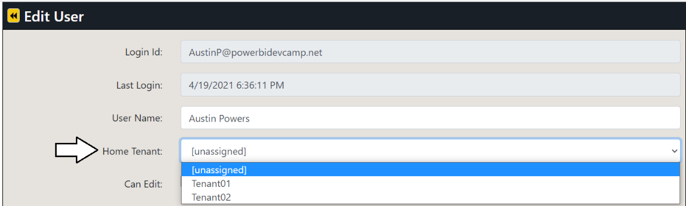
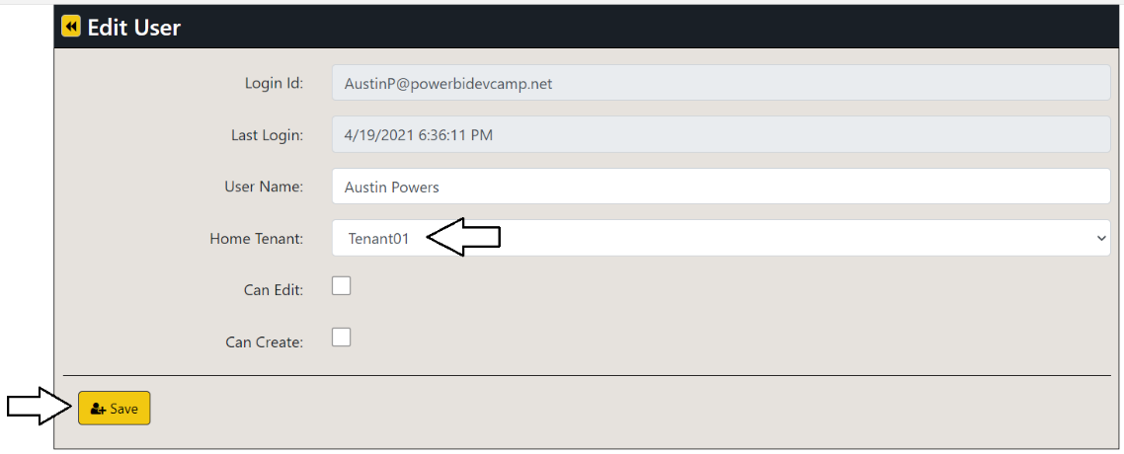
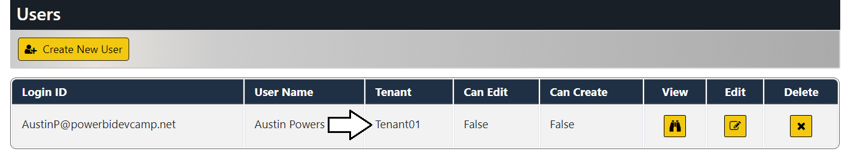
Testing User Permission Assignments
Use AppOwnsDataAdmin to move AppOwnsDataClient user through 4 possible states
Test AppOwnsDataClient when user is unassigned
Test AppOwnsDataClient when user is assigned to tenant with read-only permissions
Test AppOwnsDataClient when user is assigned to tenant with edit permissions
Test AppOwnsDataClient when user is assigned to tenant with edit + create permissions

Slide 39
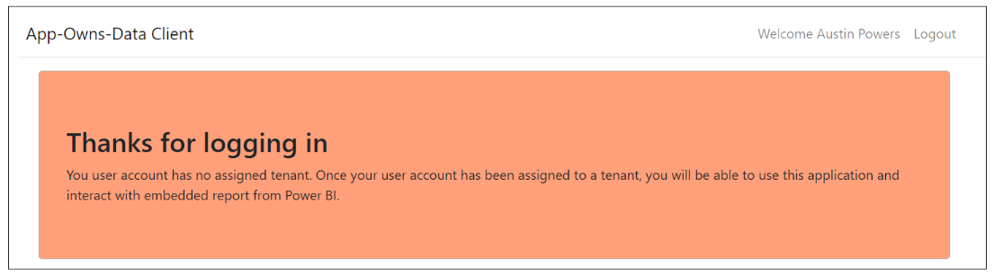
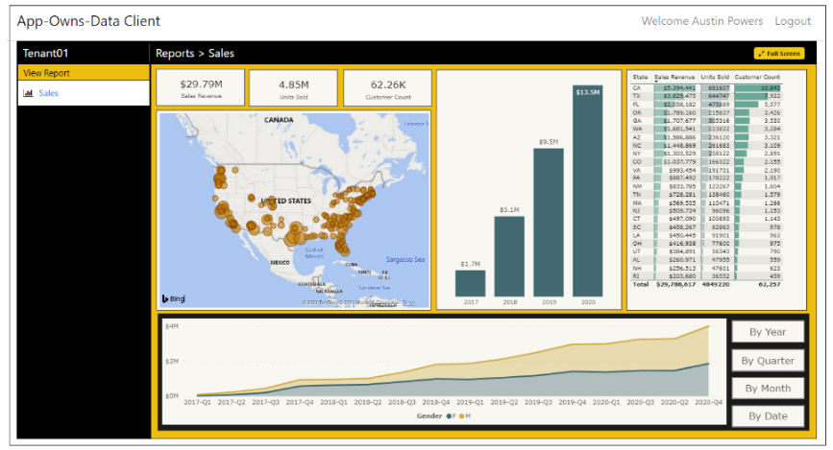
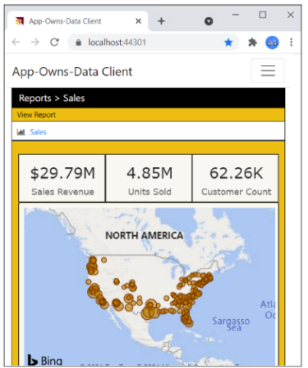
AppOwnsDataClient User Experience
Test user experience when user is unassigned
Test experience with user assigned - make browser window narrow to see mobile view

Slide 40
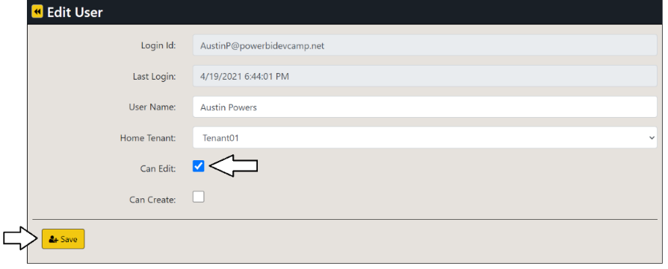
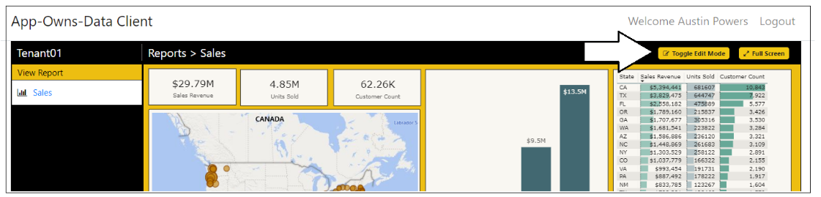
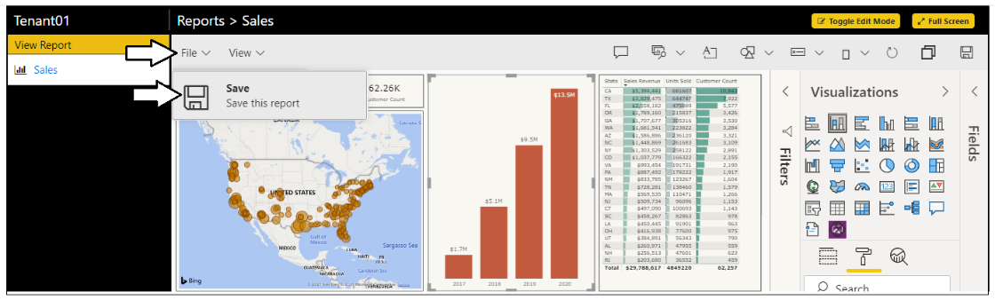
Edit reports using AppOwnsDataClient
Test user experience when user has edit permissions
User can move report into edit mode
Once in edit mode, you can customize report and save changes

Slide 41
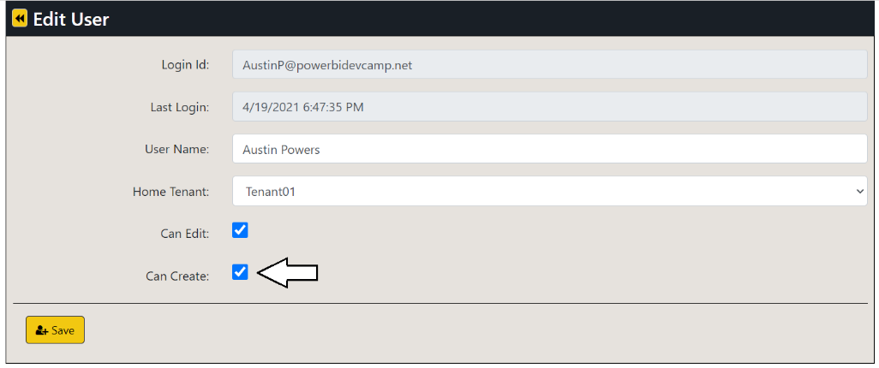
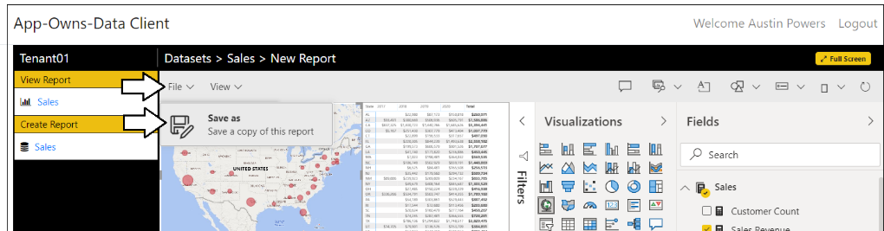
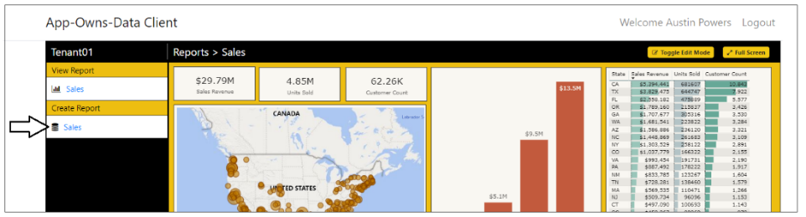
Create New Content using AppOwnsDataClient
Test user experience when user has edit + create permissions
User can use Save As command on report in edit mode to copy a report
User can click dataset link in Create Report section to create new report

Slide 42
Demo Time Running the AppOwnsDataClient Application

Slide 43
Agenda
Solution Architecture
Test the AppOwnsDataAdmin application
Test the AppOwnsDataClient application
Monitor user activity and report performance

Slide 44
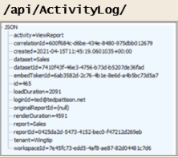
Adding a custom telemetry layer
App-Owns-Data Starter Kit demonstrates adding custom telemetry
AppOwnsDataWebApi exposes ActivityLog endpoint
AppOwnsDataClient logs custom events by posting to ActivityLog endpoint
AppOwnsDataWebApi records event activity in AppOwnsDataDB
AppOwnsDataClient
AppOwnsDataWebApi
AppOwnsDataDB

Slide 45
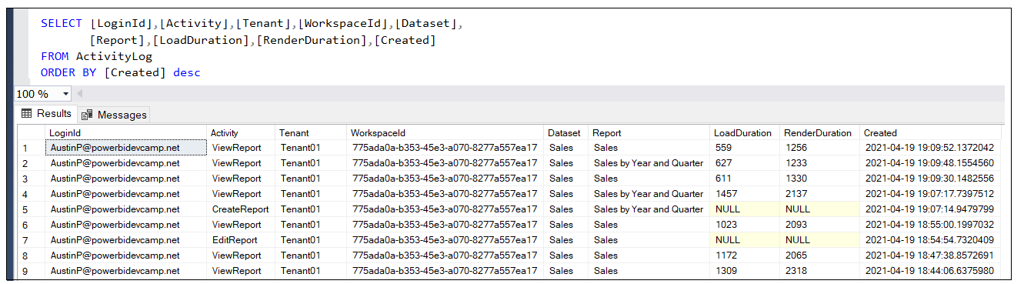
Monitor user activity data from ActivityLog table
AppOwnsDataClient constantly logs user activity
Activity is logged whenever a user views a report
Activity is logged whenever a user edits, copies or creates a report
Activity is logged by AppOwnsDataWebApi by adding record into ActivityLog table

Slide 46
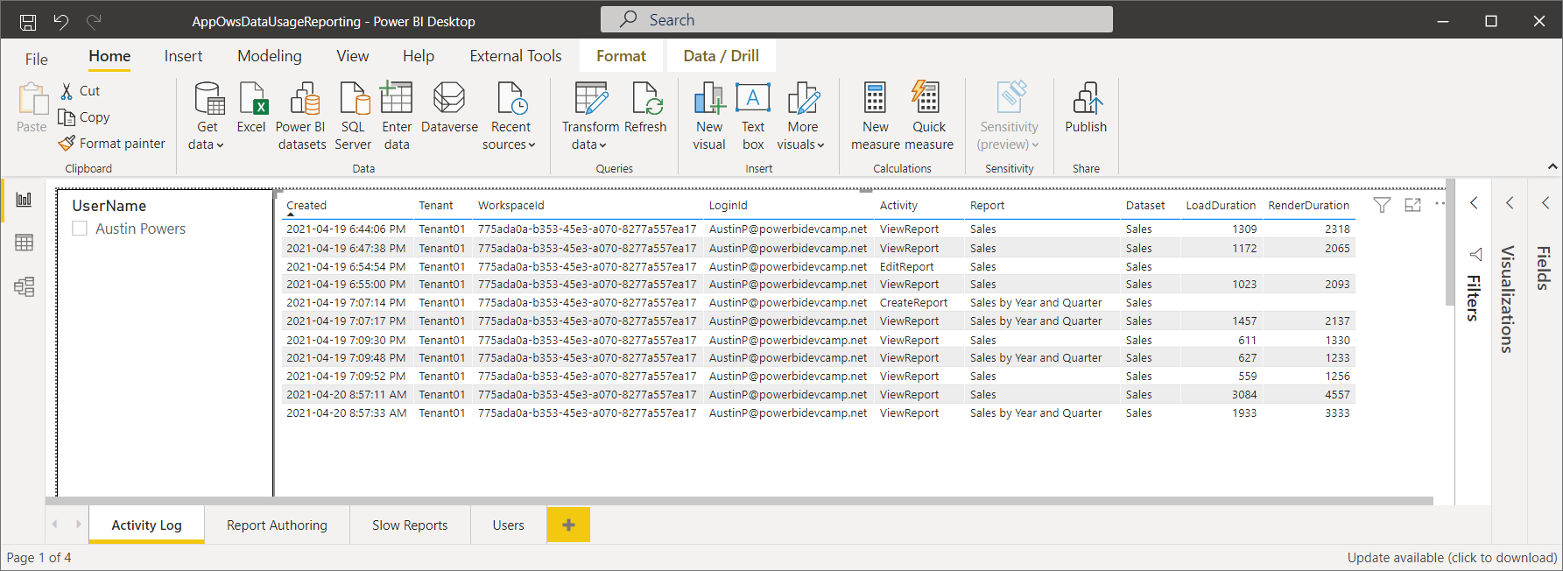
AppOwsDataUsageReporting.pbix
App-Owns-Data Starter Kit includes report template AppOwsDataUsageReporting.pbix
AppOwsDataUsageReporting.pbix imports data from AppOwnsDataDB
Allows for monitoring and analysis of usage data

Slide 47
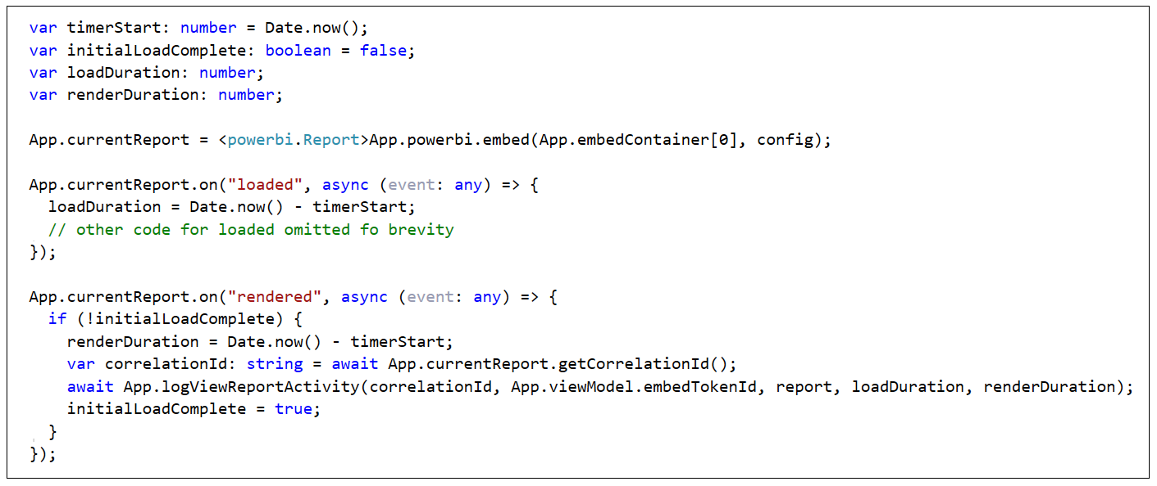

Capturing Report Performance Data
Steps to capture performance data when embedding a report
Capture time before starting the embedding process
Determine time duration between start of embedding and the loaded event
Determine time duration between start of embedding and the rendered event
LoadDuration and RenderDuration recorded in milliseconds
Activity Event Payload

Slide 48

Monitoring Report Performance
ViewReport activity logged with perf data for LoadDuration and RenderDuration
Allows for monitoring/analysis of report performance across multi-tenant environment
Allows for early detection of performance problems affecting user experience

Slide 49
Demo Time Monitoring User Activity and Report Performance

Slide 50
Summary
Solution Architecture
Test the AppOwnsDataAdmin application
Test the AppOwnsDataClient application
Monitor user activity and report performance

Slide 51
Next Steps
Use a different authentication provider
Create a more granular permissions scheme
Add integration with row-level security (RLS)
Redesign AppOwnsDataClient using React.js or Angular
Learn scaling techniques to support more than 1000 tenants

Slide 52
Next Month in Power BI Dev Camp
Building Multi-language Report

Slide 53
Summary
Solution Architecture
Set up your development environment
Open the App-Owns-Data Starter Kit in Visual Studio
Test the AppOwnsDataAdmin application
Test the AppOwnsDataClient application
Use activity logs to monitor user activity and report performance

Slide 54
Questions Microsoft Power BI

